Slide 1

A Case Study on Hospital Readmission Rates Of Diabetic patients
By Group 8: Madhavi Polisetti , Ram Shanker, Elyse Zhang
Aug 25 2018
Notes:
The three of us worked on Hospital readmissions of Diabetic patients.
It was a good learning experience in terms of learning to work with raw data and in terms of learning to work as a team.

Slide 2
Agenda
1
Introduction and Background
2
Feature Engineering and
Exploratory Analysis
3
Clustering Analysis
4
Prediction and Comparison
5
Conclusion and Recommendation
Notes:
I will briefly run through the agenda for our presentation.

Slide 3

Introduction/Background
Readmission rate to hospital is used as a measure of the quality of a hospital because a high proportion of readmissions should be preventable if the preceding care is adequate.
Readmission rate is crucial for HealthCare, Insurance as well as drug development companies.
The high prevalence of Diabetes makes it a common comorbid condition in hospitalized patients.
30-day readmission rates for hospitalized patients with Diabetes are reported to be much higher than for all hospitalized patients.
Our dataset contains more than 100,000 in-patient (admitted to hospital) diabetic encounter during 10 years (1999-2008) of clinical care at 130 US hospitals and integrated delivery networks.
Notes:
Why Patient readmissions? - read point 1.
Who else cares for improving readmission rates → read point 2.
Read point 3. Hence Point 4.
Comorbidity is coexisting long term illness.

Slide 4

Introduction- Case Study
Analyze and determine factors that are most effective in predicting readmissions?
Main Questions?
To develop and validate a tool that predicts 30 day readmission risk of hospitalized patients with diabetes
Notes:
What questions are we trying to answer -
Analyze factors that are effective in determining readmission.
Develop predictive tool for 30-day readmissions.

Slide 5
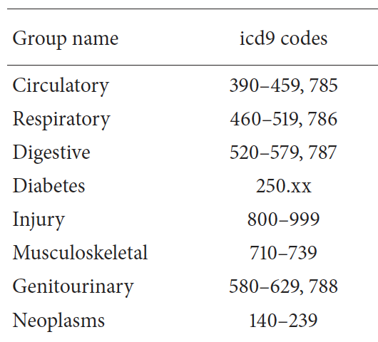
Introduction Data
The dataset contains 50 features representing patient encounters:
Patient Demographics : race, gender, age...
Admission and discharge details:
Where and how the patient was admitted
Where the patient was discharged to
Treatments, procedures and days in the facilities:
# of days in each type of facilities
# of lab tests and procedures done...
Three primary diagnoses, coded as Medical Diagnosis Codes
Laboratory test results: A1c Test, Glucose Serum Test
22 Medicines and # of medicine changes.
Response Variable: readmission
Notes:
Here are the 50 features in our dataset. Read slide.

Slide 6
Featuring Engineering
Missing Values:
Fill in with Modes: Race (2% missing )
Fill in depending on other variable value: Payer code (53% missing)
Delete: Weight (97% missing); Medical specialty (52% missing)...
Binning and Mapping categorical variables
Over 900 different Medical diagnoses binned into 9 groups based on their ICD code
Detailed admission (21 levels) and discharge (29 levels) binned into 4 to 5 groups.
Deleted patients transferred to hospice care or deceased
Combined certain variables:
22 medicines each have four levels: Up, Down, Steady and No. We combined 21 of them into one variable: # of medical dose change, except for Insulin, for which we kept all four levels.
Notes:
A.Here is how we dealt with missing data -
Smaller % of Missing values filled with modes.
Made an intelligent guess for medium % missing values (Payer_Code was Self-pay/Insured/Medicare or other)
Delete Columns with large % of missing values.
B. Variables with large no.of categories - We binned them into groups of similar types. Admission-Type? Discharge-Disp?
C. Combined 21 medicine features.

Slide 7
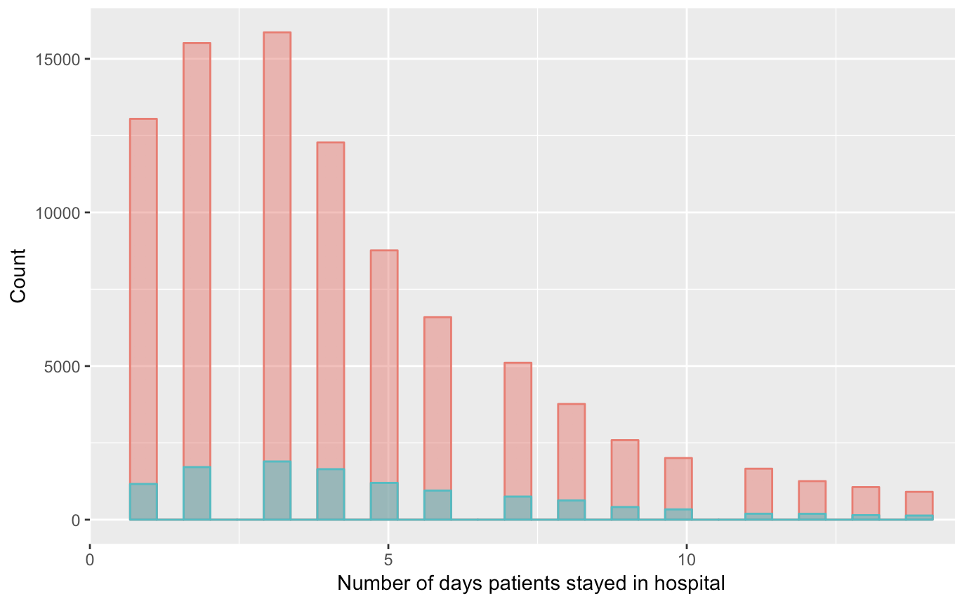
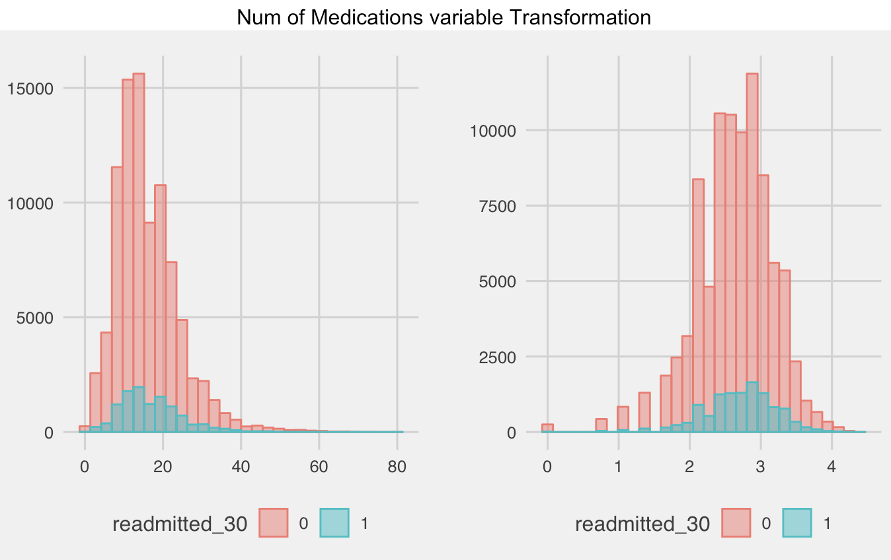
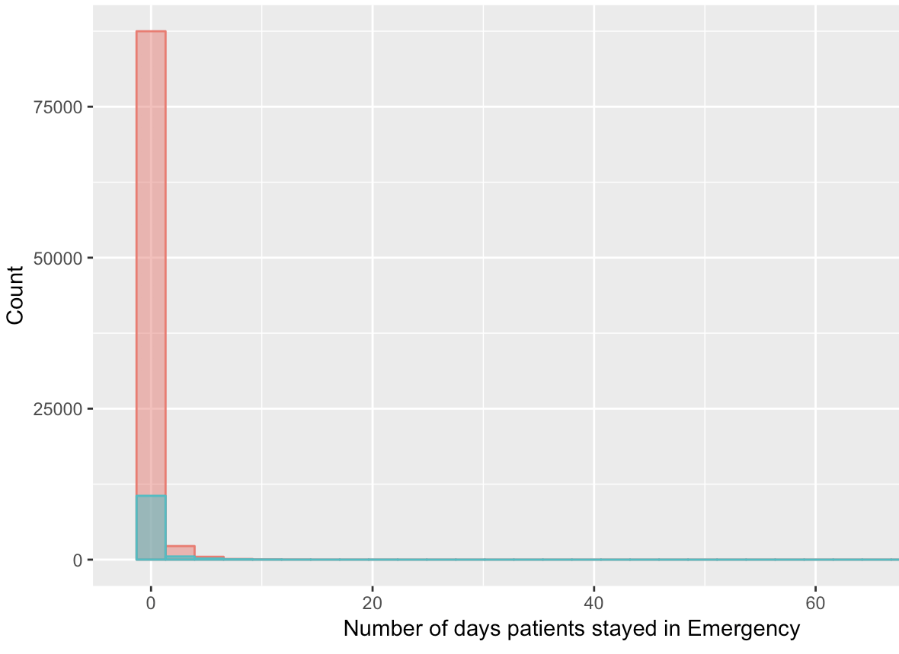
Featuring Engineering
Log transformation where applicable to a skewed variable
Binned numerical variables to categorical variables or even binary variables

Slide 8
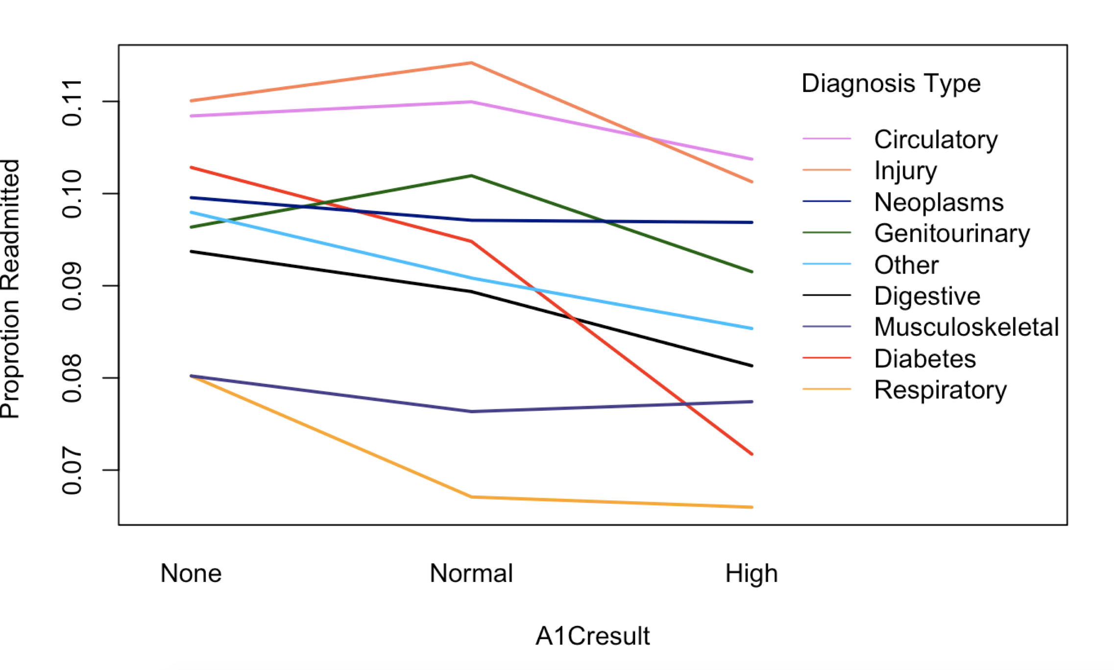
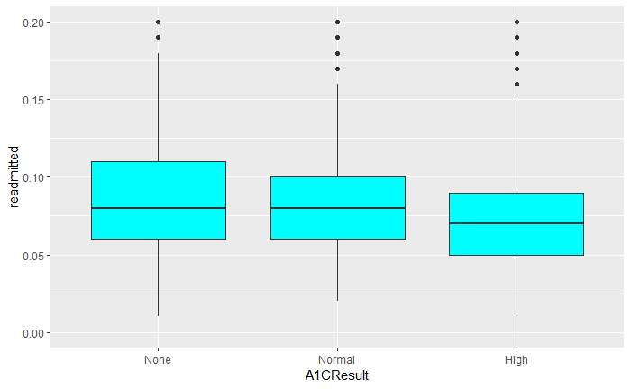
Exploratory Analysis - Interaction of HbA1C Result vs Diagnosis Type
Relationship between Probability of readmission and the HbA1c measurement depends upon the primary diagnosis.
Data suggests that greater attention to diabetes reflected in HbA1c determination may improve patient outcomes.
Notes:
We explored the interaction of HbA1C test vs. Primary Diagnosis on Readmission. When this Diabetic test is given, patient outcomes are better as shown by Graph 1.

Slide 9
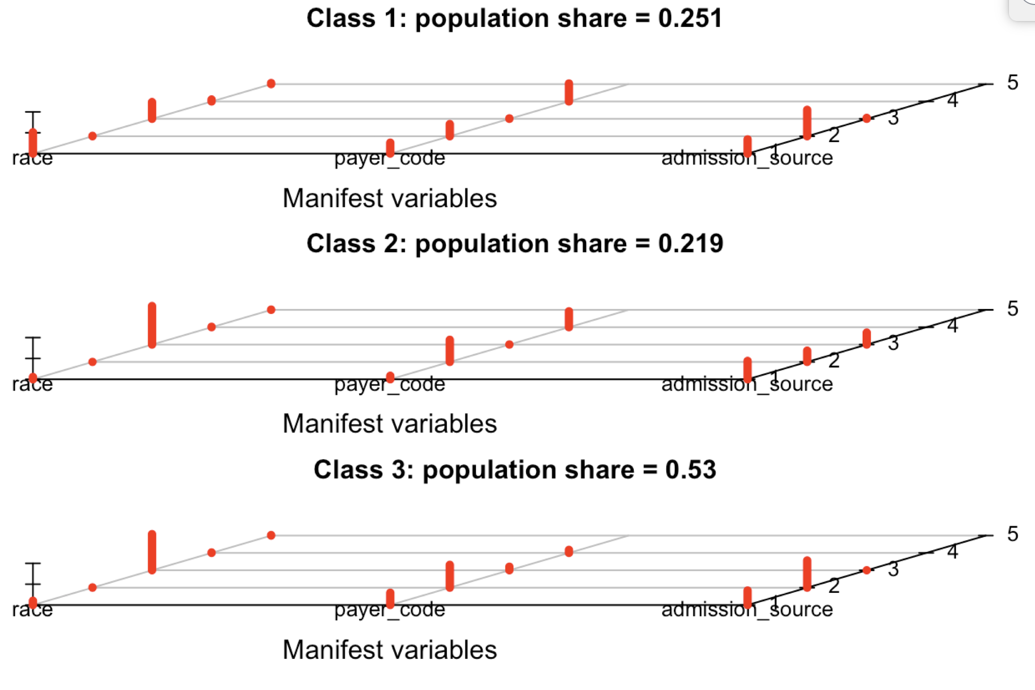
Latent Class Analysis - Patient Demographics & Admission details
Class 1 : African-American Patients, Self-paid medical expenses and admitted to Urgent Care.
Class 2 : Caucasian Patients, used Medicare for medical expenses and admitted to Urgent Care.
Class 3 : Caucasian Patients, used Medicare for medical expenses and admitted via Referrals.
Notes:
Class1 could mean In-availability of Insurance/medicare.

Slide 10
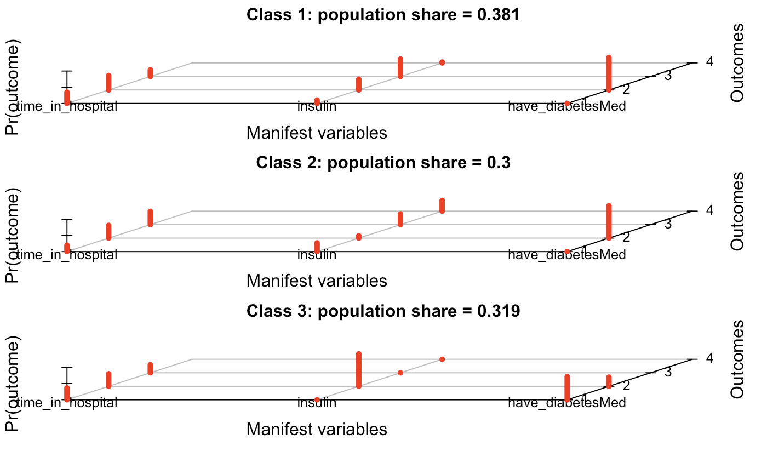
Latent Class Analysis - Treatment & Medications
Class 1 : Shorter stays in hospital, Steady insulin and on Diabetic meds.
Class 2 : Longer Stays in Hospital, Steady/High Insulin and Have Diabetic Meds
Class 3 : Shorter stays in hospital, No Diabetic Meds and No Insulin
Notes:
Inferences : Clusters with Shorter stays are associated with diabetes and Steady or No insulin. Longer stays are associated with Diabetic Meds and Insulin shots.

Slide 11
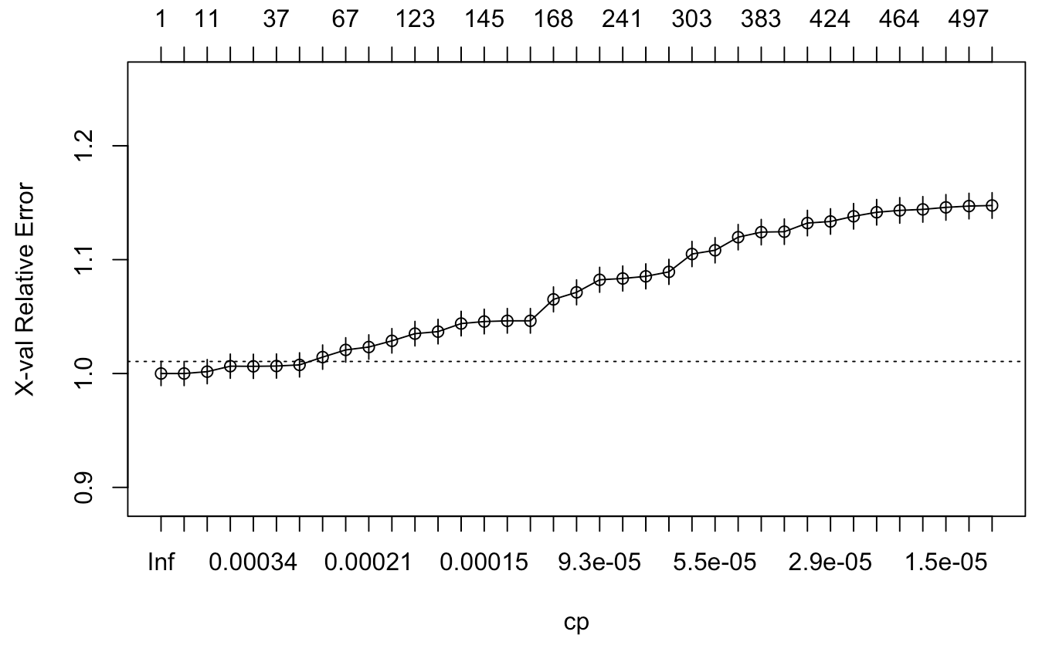
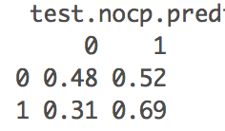
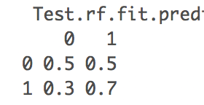
Prediction – Problem and New Concepts
Random Forest
Because of the imbalanced response variable, we were not able to prune our decision tree and were concerned about model robustness
Manually adjusting threshold for classification gave us True Positive rate 69% and True Negative 48%
Random Forest is an ensemble of decision trees, where a new random sample of features is chosen for every single tree at every single split
Improved single tree model’s both TP and TN rates slightly

Slide 12
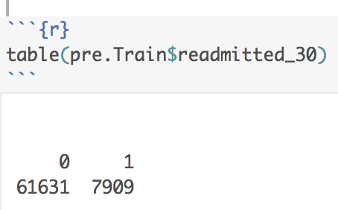
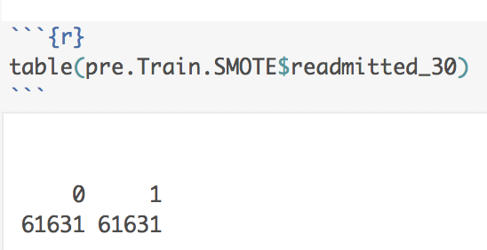
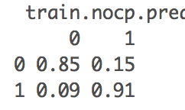
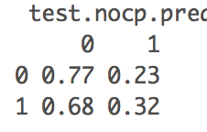
Prediction – Problem and New Concepts
SMOTE: Synthetic Minority Over-sampling Technique
Increase the number of underrepresented cases in a dataset by taking samples of the feature space for each target class and its nearest neighbors, and generates new examples that combine features of the target case with features of its neighbors.
It is not just copying of existing minority cases, so it usually performs better than simply duplicating existing cases
Oversampling the training set improved both Training and Holdout performances realistically and convincingly for Logistic Regression. However for Tree models, it improved only Training performance and performance cannot be carried over to Holdout validation at all.

Slide 13
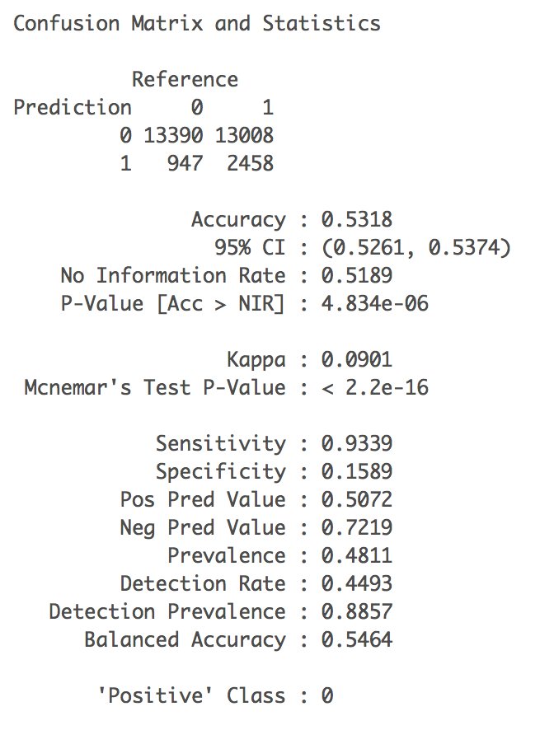
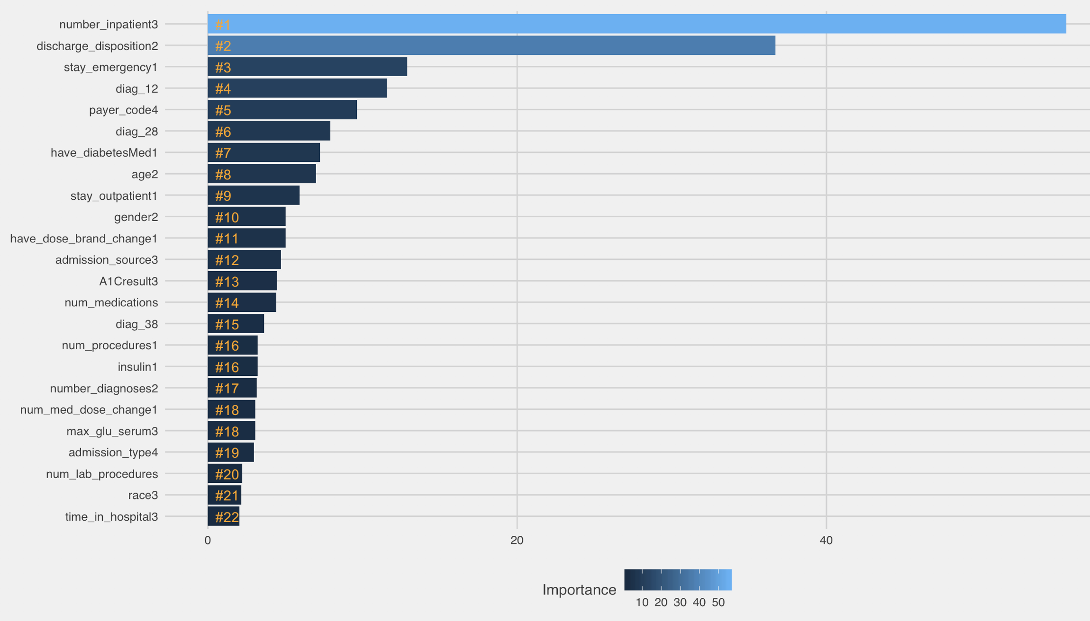
Prediction Results – Logistic Regression

Slide 14
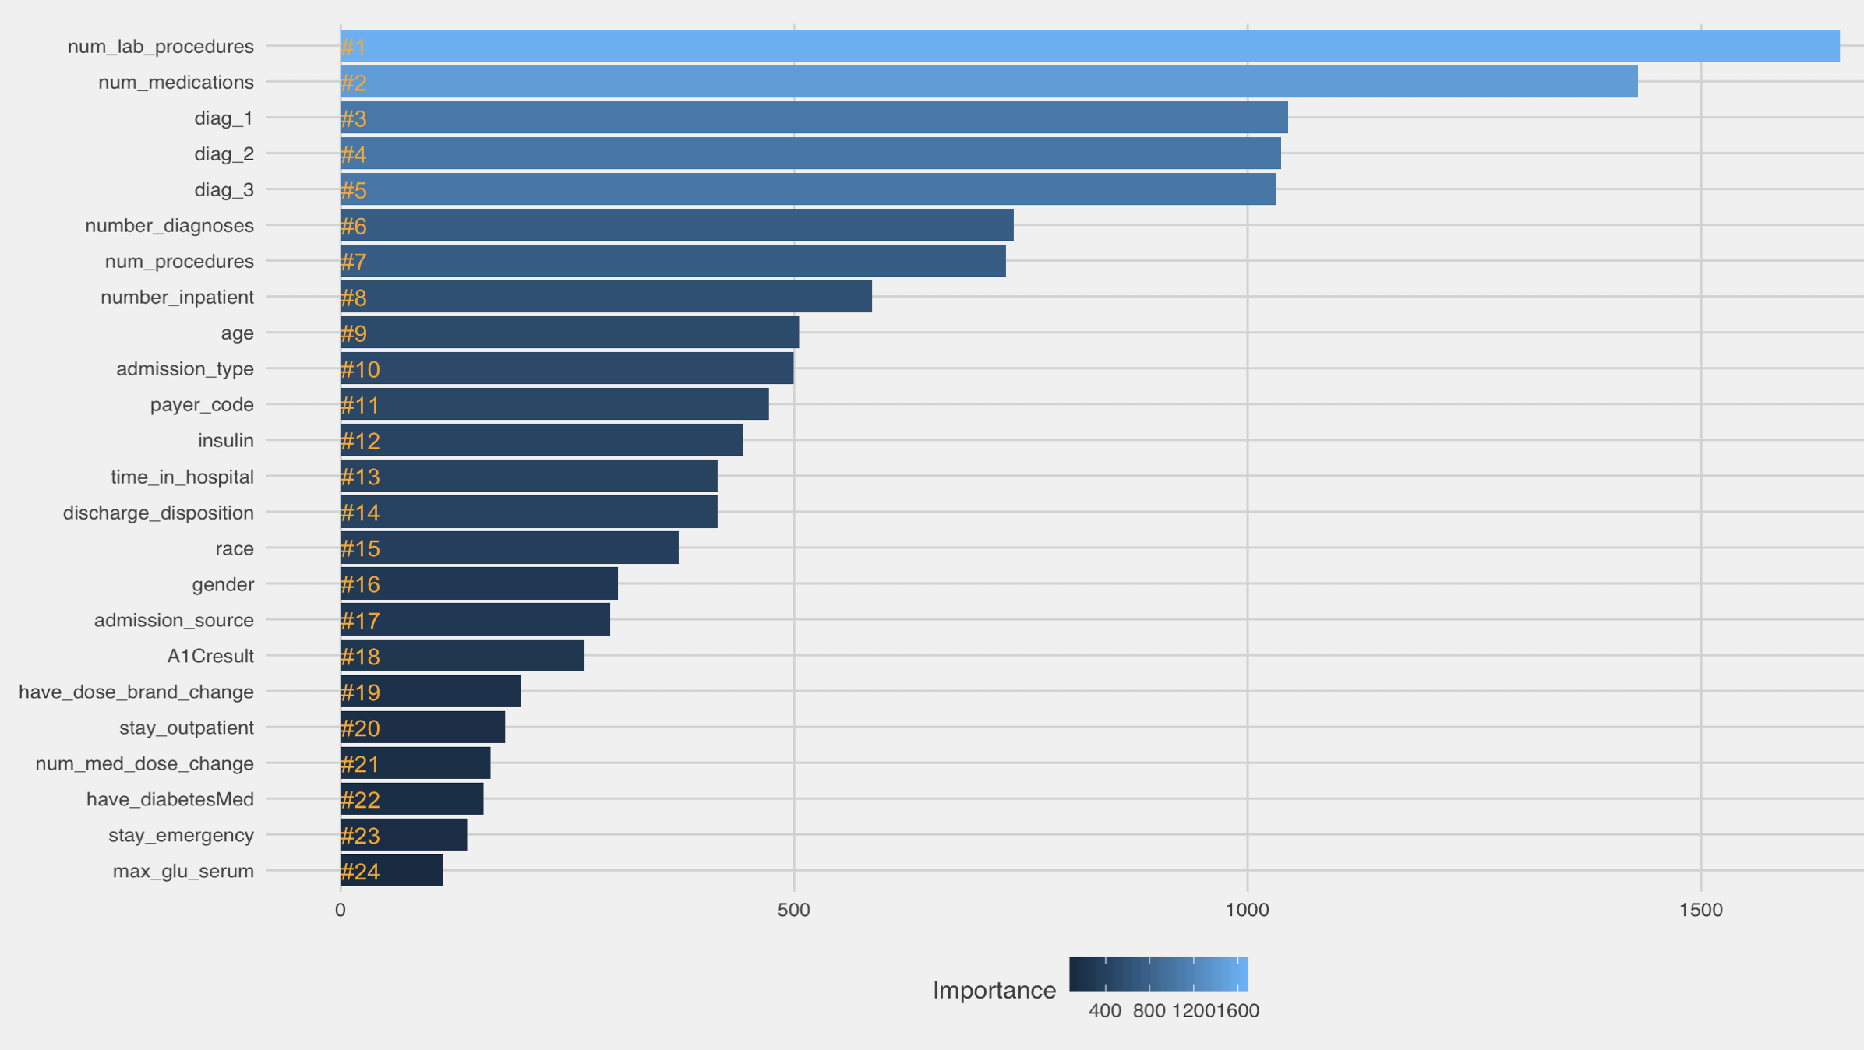
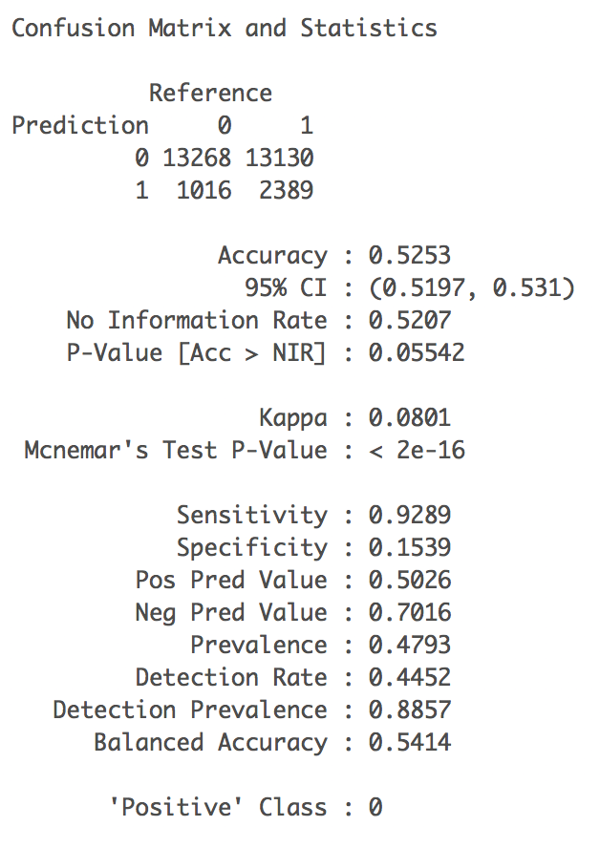
Prediction Results – Random Forest

Slide 15
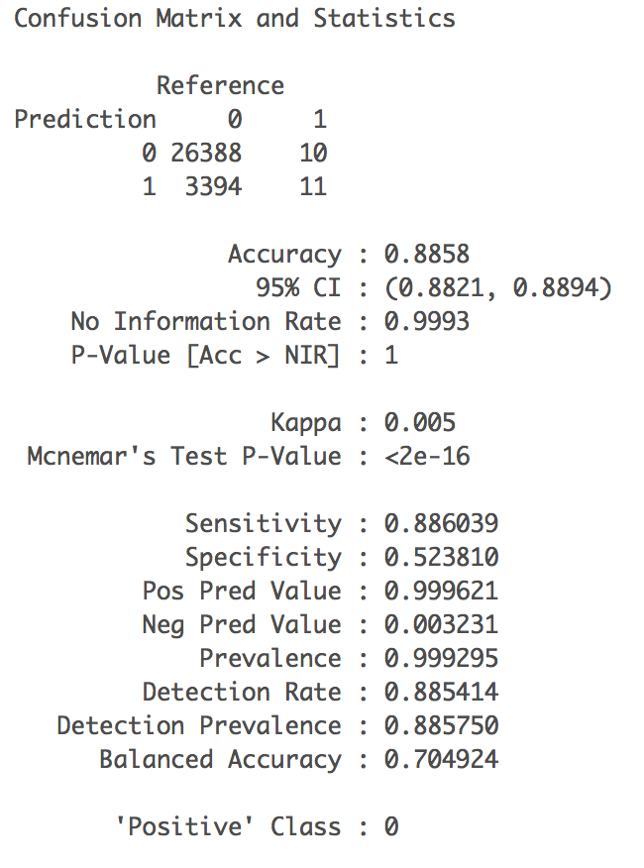
Prediction Results – Beyond Accuracy

Slide 16
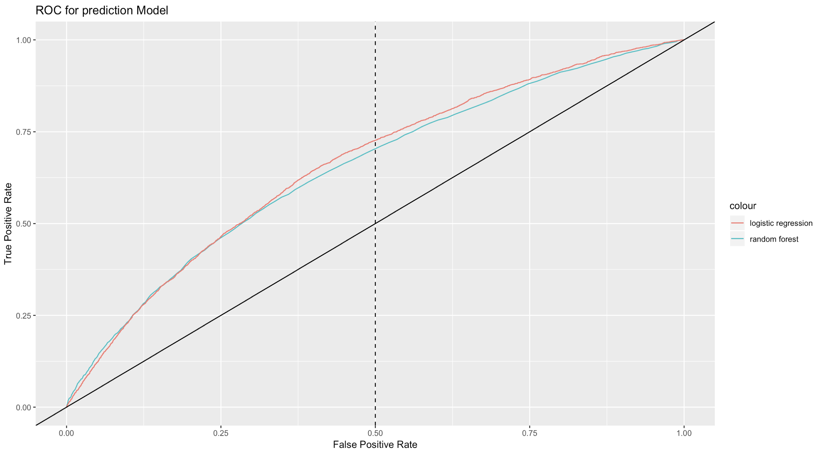
Prediction Results – Comparison

Slide 17
Prediction Results – Comparison

Slide 18
Conclusion
Analyze and determine factors that are most effective in predicting readmissions?
Main Questions?
To develop and validate a tool that predicts 30 day readmission risk of hospitalized patients with diabetes

